Slide 1
PROJECT -1
FINLATICS – ENABLING INSIGHTS
Presented BY - PRAVAL GUPTA

Slide 2
Facebook LIVE SELLERS data SET
QUESTIONS
How does the time of upload (`status_published`) affect the `num_reaction`?
Is there a correlation between the number of reactions (num_reactions) and other engagement metrics such as comments (num_comments) and shares (num_shares)? If so, what is the strength and direction of this correlation?
Use the columns status_type, num_reactions, num_comments, num_reactions, num_likes, num_loves, num_wows, num_hahas, num_sads, and num_angrys to train a K-Means clustering model on the Facebook Live Sellers dataset.
Use the elbow method to find the optimum number of clusters.
What is the count of different types of posts in the dataset?
What is the average value of num_reaction, num_comments, num_shares for each post type?

Slide 3
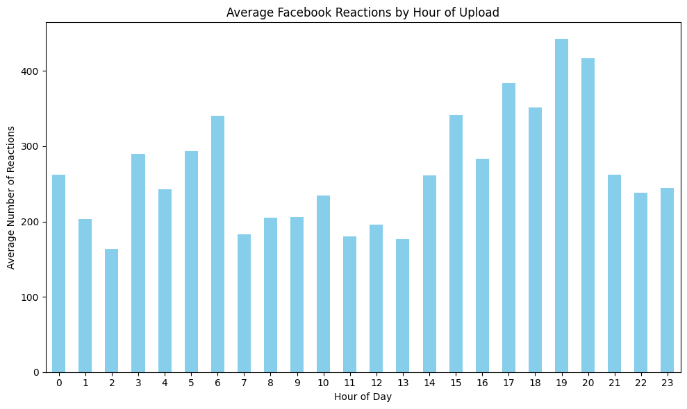
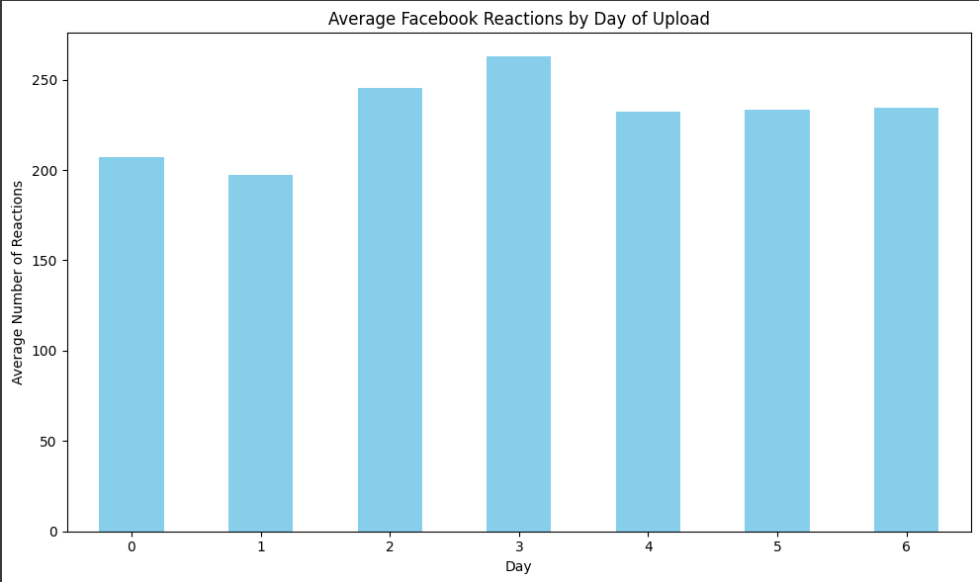
Q1. How does the time of upload (`status_published`) affect the `num_reaction`?
Interpretation and Conclusion:
The above first bar graph shows the relation between the Time of Upload (hourly basis)and
the number of reactions(num_reaction).
The above first bar graph shows the relation between the Time of Upload (hourly basis)and
the number of reactions(num_reaction).
Posts uploaded around 19 : 00 tend to receive the highest number of reactions on average.
Posts uploaded around 2 : 00 tend to receive the lowest number of reactions on average.
Posts uploaded on Thursday tend to receive the highest number of reactions on average.
Posts uploaded on Tuesday tend to receive the lowest number of reactions on average.
To maximize engagement,consider posting content in the evening around 19:00 and especially on Thursdays.

Slide 4
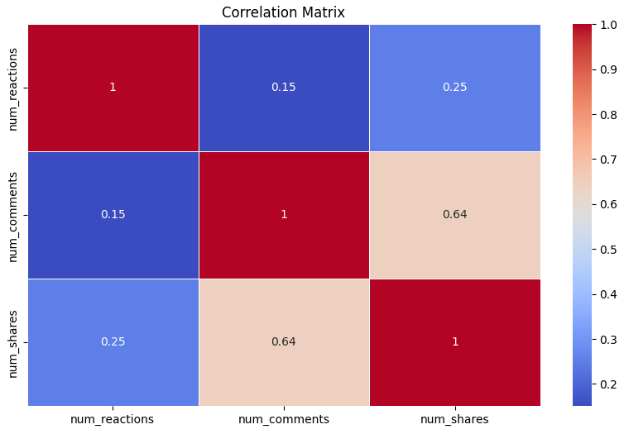
Q2. Is there a correlation between the number of reactions (num_reactions) and other engagement metrics such as
comments (num_comments) and shares (num_shares)? If so, what is the strength and direction of this correlation?
Interpretation and Conclusion:
As the value of the Correlation coefficient
between the variables num_reactions and
num_comments is 0.15084290344217685, it
represents a Weak Correlation which suggests
a faint relationship in the positive direction
that might not be practically significant.
As the value of the Correlation coefficient
between the variables num_reactions and
num_shares is 0.25072251662831907, it
represents a Weak Correlation which suggests
a faint relationship in the positive direction
that might not be practically significant.

Slide 5
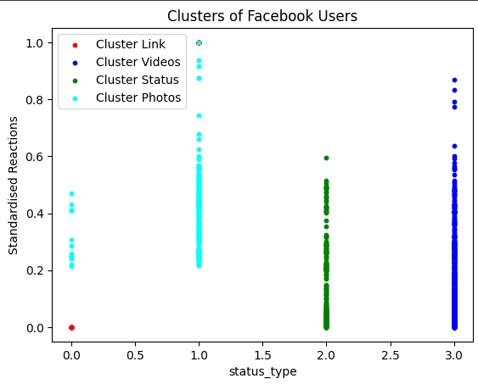
Q3. Use the columns status_type, num_reactions, num_comments, num_reactions, num_likes, num_loves, num_wows, num_hahas, num_sads, and num_angrys to train a K-Means clustering model on the Facebook Live Sellers dataset.
Interpretation:
Videos generate the highest level of active engagement. They receive the highest number of shares. They show the widest range of standardized reactions (0 to 0.9). Two distinct sub-clusters are visible: high-engagement photos 0.5-0.9) and moderate-to-low engagement photos (0-0.6). Videos elicit the most diverse emotional responses, showing the highest values for "loves," "wows," "hahas," "sads," and "angrys“.
Photos show the most polarized engagement pattern, with some generating very high reaction counts while others receive minimal engagement. The number of photos count is also very much high due to which, it also has relatively high engagement. Relatively low comment counts and Minimal sharing behaviour. Standardized reactions span from approximately 0.2 to 1.0, with many concentrated between 0.3-0.6.
Status updates generate substantial passive engagement (reactions) but less active
participation compared to videos. Moderate comment engagement and Low sharing rates
similar to photos. Standardized reactions primarily concentrate between 0.1-0.5

Slide 6
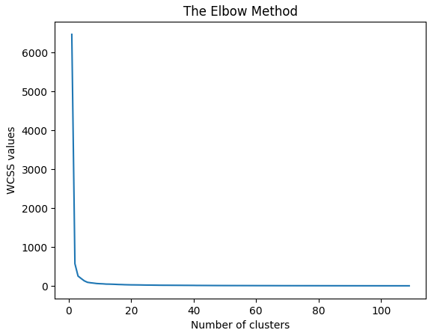
Links generate passive engagement with limited emotional diversity or active participation.
Links show the most concentrated pattern with reactions primarily between 0 and 0.45. Lowest
comment engagement and Limited sharing behaviour.
Q4. Use the elbow method to find the optimum number of clusters.
The optimal number of clusters is determined
where there is an elbow joint in the graph
i.e. where the WCSS value starts decreasing
Slowly
The optimal number of clusters (elbow) is: 4

Slide 7
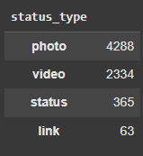
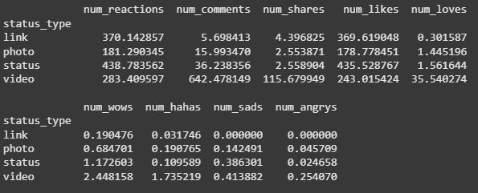
Q5. What is the count of different types of posts in the dataset?
Q6. What is the average value of num_reaction, num_comments, num_shares for each post type?

Slide 8
Sales PREDICTION data SET
QUESTIONS
What is the average amount spent on TV advertising in the dataset?
What is the correlation between radio advertising expenditure and product sales?
Which advertising medium has the highest impact on sales based on the dataset?
Plot a linear regression line that includes all variables (TV, Radio, Newspaper) to predict Sales, and visualize the model's predictions against the actual sales values.
How would sales be predicted for a new set of advertising expenditures: $200 on TV, $40 on Radio, and $50 on Newspaper?
How does the performance of the linear regression model change when the dataset is normalized?
What is the impact on the sales prediction when only radio and newspaper advertising expenditures are used as predictors?

Slide 9
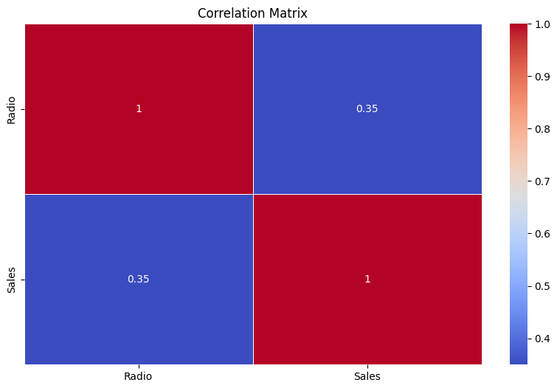
Q1. What is the average amount spent on TV advertising in the dataset?
Average TV Advertising Cost: 147.0425
Q2. What is the correlation between radio advertising expenditure and product sales?
Interpretation and Conclusion:
As the value of the Correlation coefficient between the variables Radio Expenditure and is 0.3497277129207838, it represents a Weak Correlation which suggests a faint relationship in the positive direction that might not be practically significant.

Slide 10
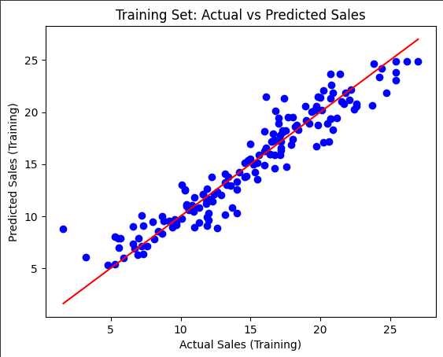
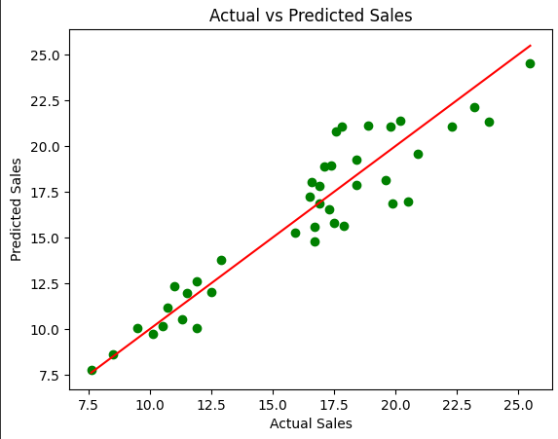
Q4. Plot a linear regression line that includes all variables (TV, Radio, Newspaper) to
predict Sales, and visualize the model's predictions against the actual sales values.

Slide 11
Interpretation :
The scatter plot displays the actual sales on the x-axis and the predicted sales from your linear regression model on the y-axis.
Each green dot represents a data point (a campaign), showing the relationship between actual and predicted sales.
The red line is the line of perfect prediction (y = x), where predicted sales would exactly equal actual sales.
The data points are tightly clustered around the red line, indicating that the model’s predictions are very close to the actual sales values.
There is a strong positive linear relationship between actual and predicted sales, suggesting that the model has captured the underlying pattern in the data well.
Conclusion :
The linear regression model provides accurate and reliable predictions of sales based on the input features (likely TV, Radio, and Newspaper advertising spend, given your dataset).
R^2 score on test set: 0.8747286106321062

Slide 12
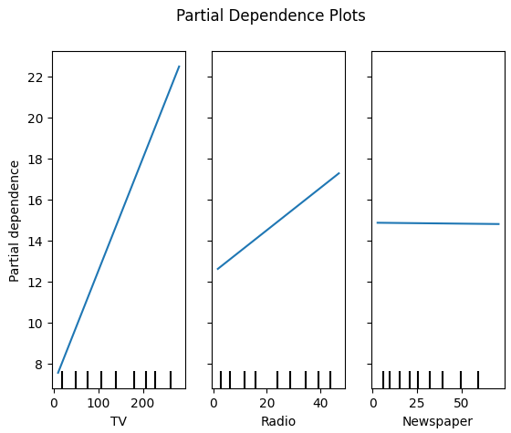
Q3. Which advertising medium has the highest impact on sales based on the dataset?
By evaluating the coefficients of linear regression
model we can determine whh medium has the highest
impact on sales.
TV: 0.0551
Radio: 0.1031
Newspaper: -0.0009
Clearly, we can see that the feature Radio has the highest coefficient of regression which implies that the Radio has the highest impact on sales based on the dataset.

Slide 13
Q5. How would sales be predicted for a new set of advertising expenditures: $200 on TV, $40 on Radio, and
$50 on Newspaper?
Predicted sales: 19.732
Q6. How does the performance of the linear regression model change when the dataset is normalized?
R^2 score on test set (scaled): 0.8747286106321063
R^2 score on test set (unscaled): 0.8747286106321062
The performance of the model remains the same as the R^2 score remains the same
even if we normalize the data set.
But, the coefficients of linear regression gets changed due to normalize which
changes the impact of the advertising medium on the sales.
TV: 4.8125
Radio: 1.5665
Newspaper: -0.0193

Slide 14
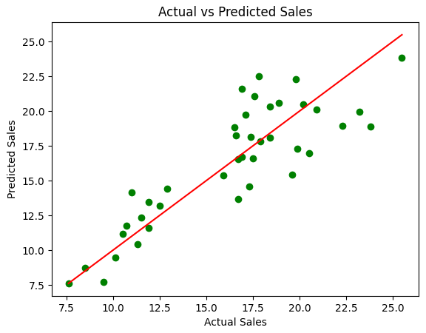
Q7. What is the impact on the sales prediction when only radio and newspaper advertising
expenditures are used as predictors?
R^2 score on test set (reduced): 0.7261531414744891
R^2 score on test set: 0.8747286106321062
The performance gets reduced if we use only
the data of radio and Newspaper for linear
regression model.
By removing TV, the model may lose important information, leading to:
Lower R² (poorer fit)
Higher Error (worse predictions)
The impact of removing TV advertising as a predictor is a significant drop in model performance, indicating that TV spending has the strongest relationship with sales.

Slide 15
THANK YOU

